Slide 1
ePermitting modules
Chunks of functionality, in progress and possible for the future, for the Forest Service’s ePermitting system
in partnership with the U.S. Forest Service

Slide 2
Background
ePermitting modules

Slide 3
Set vision
Conduct research
Build modules

Slide 4
Module ≠ BPA buy
Multiple modules may be incorporated into one buy. A module may be split into multiple buys. Modules are a strategic unit, not an acquisition one. These modules are not yet prioritized.

Slide 5
In progress
ePermitting modules

Slide 6


SUDS API/ Developers can connect ePermitting to SUDS easily
Module in progress
What we’re after: A RESTful API endpoint with a simple schema for ePermitting developers to use.
Why: Without an API connection to SUDS, we can’t make any other modules operational. SUDS is also complicated and changing. We want to shield our developers from its innards and let them focus on the user experience instead of database interface.

Slide 7


Intake/
Applicants can submit their forms and documents
Module in progress
What we’re after: Applicants can submit the forms and activity-dependent documentation that compose a non-commercial group use or temporary outfitter/guide application.
Why: An activity-dependent application form will address the most common applicant complaint: wildly varying documentation requirements between forests.

Slide 8
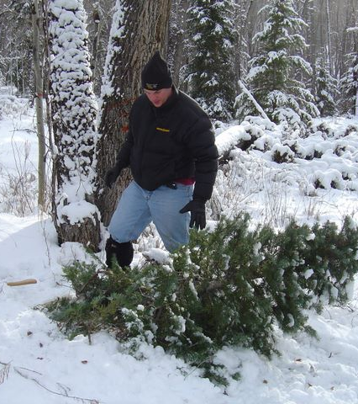

Christmas trees/ People can purchase and print Christmas tree tags online
Module in progress
What we’re after: People can purchase (via pay.gov) and print tags they attach to Christmas trees.
Why: Issuing tags online will circumvent or minimize much of the staff effort involved in tracking, reconciling sales of, and reporting on tag sales. This module will also make Christmas tree tags available outside of FS district offices.
Notes:
- pay.gov integration
- tim integration
- xmas tree purchase frontend + permit printing

Slide 9
Possible future modules
ePermitting modules

Slide 10

TIM API/
Developers can connect ePermitting to TIM easily
Possible future module
What we’re after: RESTful API endpoint with a simple schema for ePermitting developers to use.
Why: TIM is complicated. We want to shield our developers from its innards and let them focus on the user experience instead of database interface.

Slide 11


Payments/ Outfitters and guides can pay their special use permit fees online
Possible future module
What we’re after: Outfitters and guides pay their bills through the same system the used to apply to their frameworks.
Why: Although outfitters and guides can pay bills online through some forests, they should not have to interact with more than one Forest Service system over their service journey. This module would consolidate that payment.

Slide 12


Mapping/
Applicants can submit maps with online applications
Possible future module
What we’re after: Applicants can indicate the location and/or route of their activity on an interactive map accompanying their location.
Why: A clear location map will reduce miscommunications about location, a common permit administrator and applicant complaint.

Slide 13


Clarifications/ Applicants can submit responses to admin. requests
Possible future module
What we’re after: After receiving a permit application, permit administrators can request additional documentation and applicants can submit it.
Why: When exchanging documentation via email, it often “fall through the cracks” without a consolidated list of what applicants still need to submit.

Slide 14
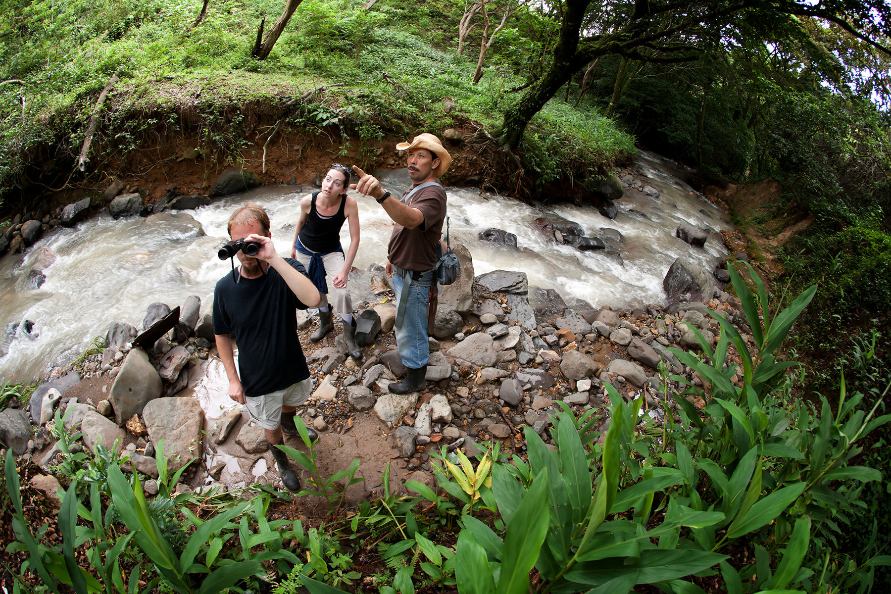

Use reporting/ Outfitters/guides can submit their use reports online
Possible future module
What we’re after: Outfitters/guides can upload spreadsheets describing their forest use in a variety of formats and calculate usage fees. Summaries of their use flow to SUDS and permit administrators.
Why: Many outfitters and guides have to submit use forms redundant to their systems and permit admins. have to manually enter them.

Slide 15
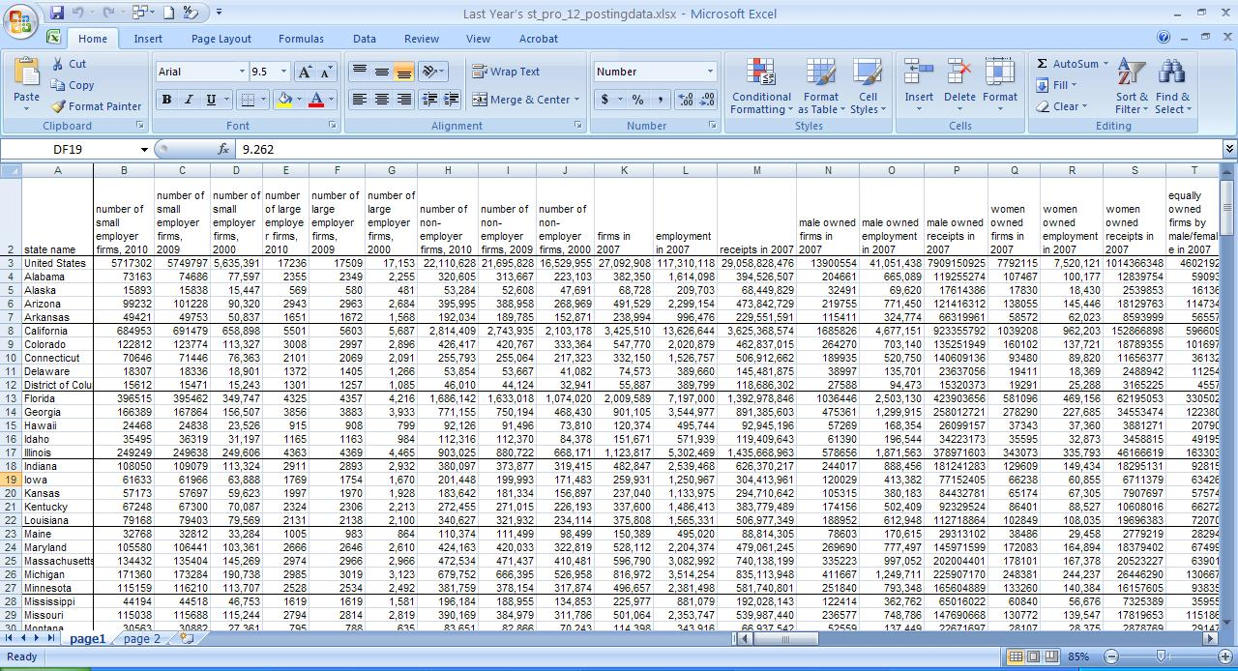

Reconciliation/
Staff can easily reconcile permits and revenue
Possible future module
What we’re after: Staff can view a report that compares the amount of revenue received with the number of permits issue (through ePermit or other sources)
Why: The current reconciliation process discovers systematic errors and ensures data accuracy, but is currently time-consuming and manual.

Slide 16
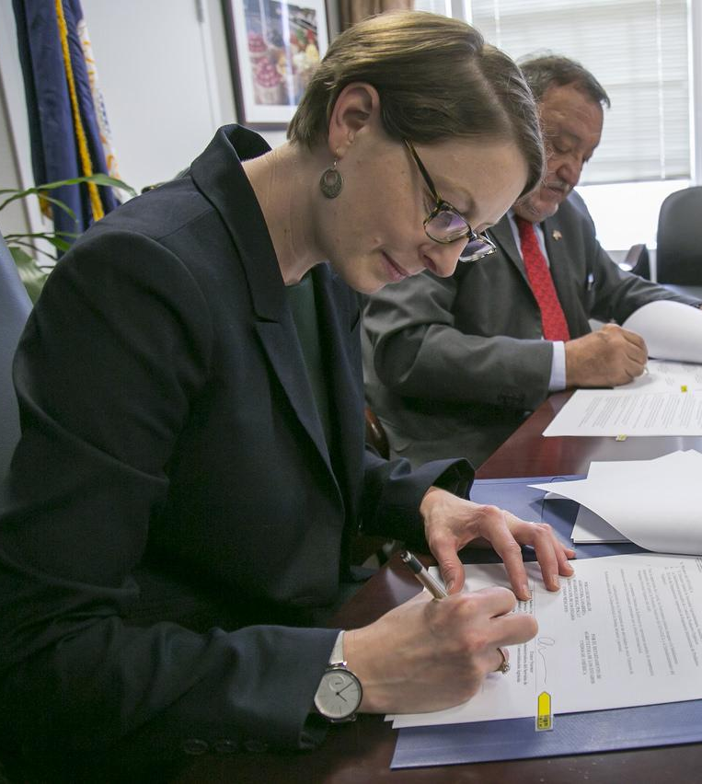

Signatures/
Permit admins. can share permits for signature online
Possible future module
What we’re after: After permits are issued, permit administrators can gather their signatures electronically.
Why: Currently, exchanging paper documents and gathering signatures adds weeks to an already long permit process.

Slide 17


Customization/
System admins can change some aspects of system
Possible future module
What we’re after: Forest service administrators (at the national level) can modify some of the questions ePermitting asks of permittees.
Why: As regulations change, applicant requirements change. The forest service shouldn’t have to contract developers every time it wants to make a minor application tweak.

Slide 18
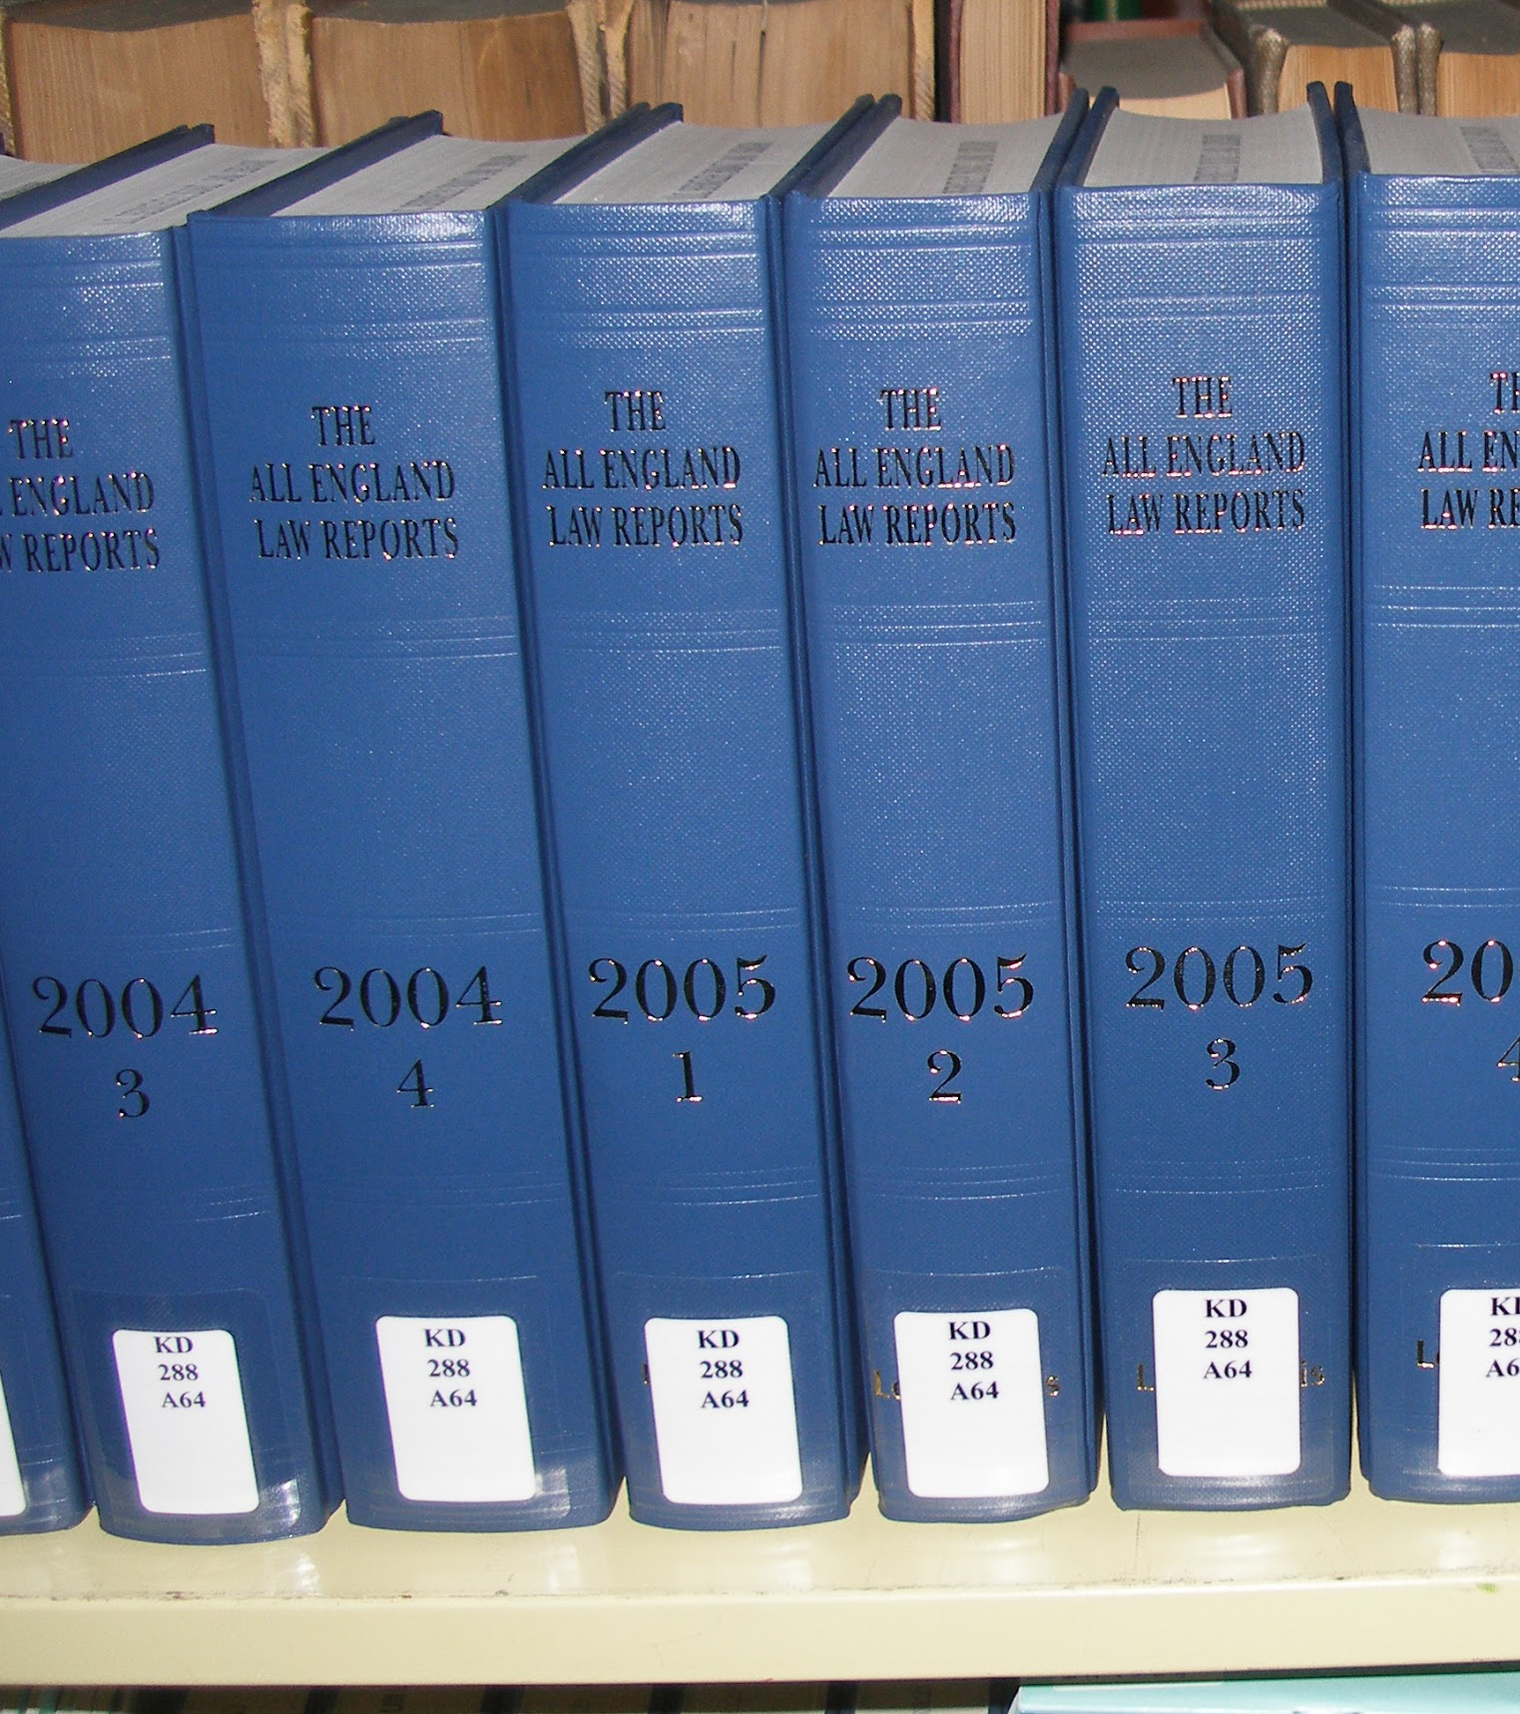

Reporting/
Permit admins. can generate basic reports on ePermits
Possible future module
What we’re after: Permit administrators can generate basic reports about the number and types of ePermit applications they receive.
Why: Although SUDS and TIM will continue to handle the bulk of the reporting on special uses and forest products, the ePermitting system should offer basic statistics on its use.

Slide 19
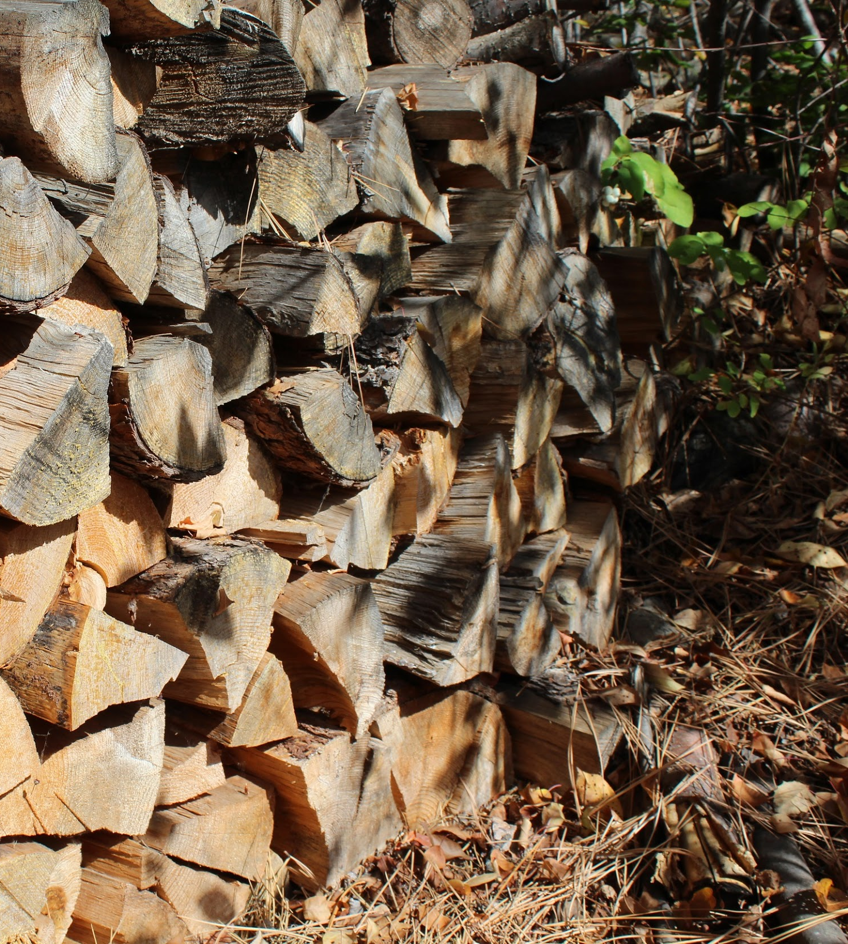

Firewood/ People can purchase and print firewood tags online
Possible future module
What we’re after: People can purchase and print firewood harvesting tags in the same way as Christmas trees.
Why: Like with Christmas trees, issuing these permits online will reduce back office work.

Slide 20
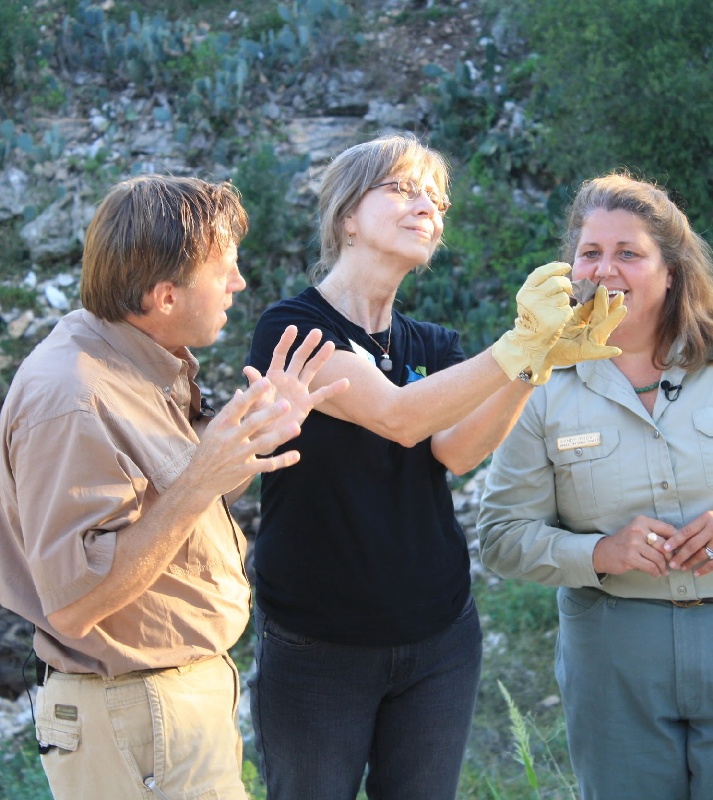

Tracker/ Outfitters can track the progress of their application
Possible future module
What we’re after: Outfitters and guides can track the progress of their application through the Forest Service’s evaluation process after they submit it online
Why: One of the outfitters and guides most common complaints is how little information they get about a permit after it’s submitted.

Slide 21
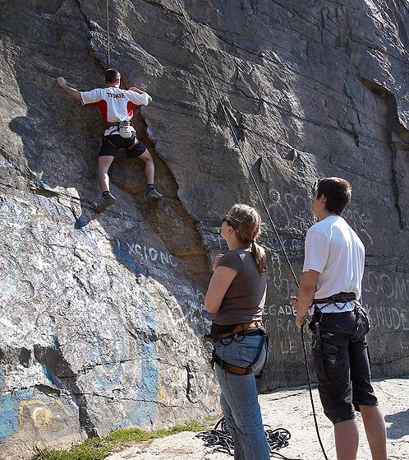

Account/ Outfitters can reuse their answers in multiple applications
Possible future module
What we’re after: Outfitters and guides can log in and reuse information from previous applications in new ones.
Why: Outfitters and guides submit the same information to many districts and forests within which they operate. Reusing this information will decrease the time it takes to renews.

Slide 22
Icon and image credits
API icon by Vicons Design from Noun Project
Form icon by Icons fest from Noun Project
Christmas tree icon by Felipe Alvarado from Noun Project
Map icon by AFY studio from Noun Project
Question icon by dilayorganci from Noun Project
Graph, gear icons by Iconic from Noun Project
Scales icon by Edward Boatman from Noun Project
Firewood icon by Alice Noir from Noun Project
Checkbook icon by Icon Fair from Noun Project
Signature icon by Delwar Hossain from Noun Project
Report icon by ProSymbols from Noun Project
All other images public domain from government websites

